Slide 1
Net Benefit
25th January 2022

Slide 2
Introduction
Statistical measures are gauge performance of models and diagnostic tests
Area under the ROC curve
Calibration plot / slope
sensitivity / specificity
Not very informative for clinical practice
Vickers and Elkin introduced the concept of net benefit in 2006 to help with clinical decision making
Notes:
How much value added to disease management?

Slide 3
Example: Biopsy for prostate cancer
Men with elevated PSA are at higher risk of prostate cancer, of those…
Only some have high-grade prostate cancer
Most have no cancer or low-grade tumors
Possible approaches:
Biopsy for all men at risk
No biopsy
Biopsy for those with elevated levels of a new molecular marker
Biopsy for those predicted to be positive according to statistical model

Slide 4
Example: Biopsy for prostate cancer
Dilemma: benefit of early detection vs. harms of biopsy
→ Solution: compare net benefit of all approaches
Net benefit = benefit – harm
→ Key idea: bring benefit & harm on the same scale
Notes:
Intervention needed for high-grade tumor
Discomfort, risk of infection

Slide 5
Exchange rate
Conversion factor
Reflects ambivalence in clinical decision making
minimum probability of disease (cancer) at which further intervention (biopsy) would be warranted
If 1%, doctors would avoid biopsy
If 99% doctors would recommend biopsy
If 10% doctors would be ambivalent – “wouldn’t do more than 10 biopsies to find one high-grade cancer”
Exchange rate = 1:9
Notes:
Overall utility of treating all patients to be equal to treating no one

Slide 6
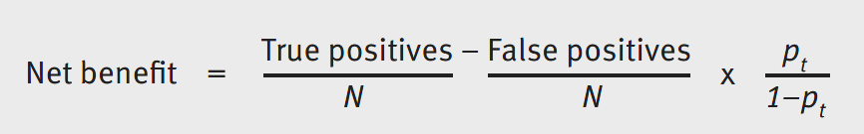
Calculating net benefit
N is total sample size
p_{t} is the threshold probability
The same value is used to classify predictions from model
benefit
harm
Exchange rate

Slide 7
Calculating net benefit (N=100)
Assuming a threshold probability of 0.1
 | True positives | False positives | Calculations | Net benefit
Biopsy for all men at risk | 25 | 75 | 0.25 - 0.75 * (1/9) | 16.7%
No biopsy | n/a | n/a | n/a | 0
With new molecular marker | 22 | 50 | 0.22 - 0.5 * (1/9) | 16.4%
Prediction model | 25 | 60 | 0.25 – 0.6* (1/9) | 18.3%

Slide 8
Interpreting net benefit
Unit of benefit is true positives
16.7% → net benefit of 167 in 1000 at risk
Magnitude doesn’t matter; rank does
Higher net benefit wins
Analogy: net profit
Benefits | 25 true positives
Harms | 75 false positives
Net benefit | 167 in 1000 men at risk
Sales | 70$
costs | 40$
Net profit | 30$

Slide 9
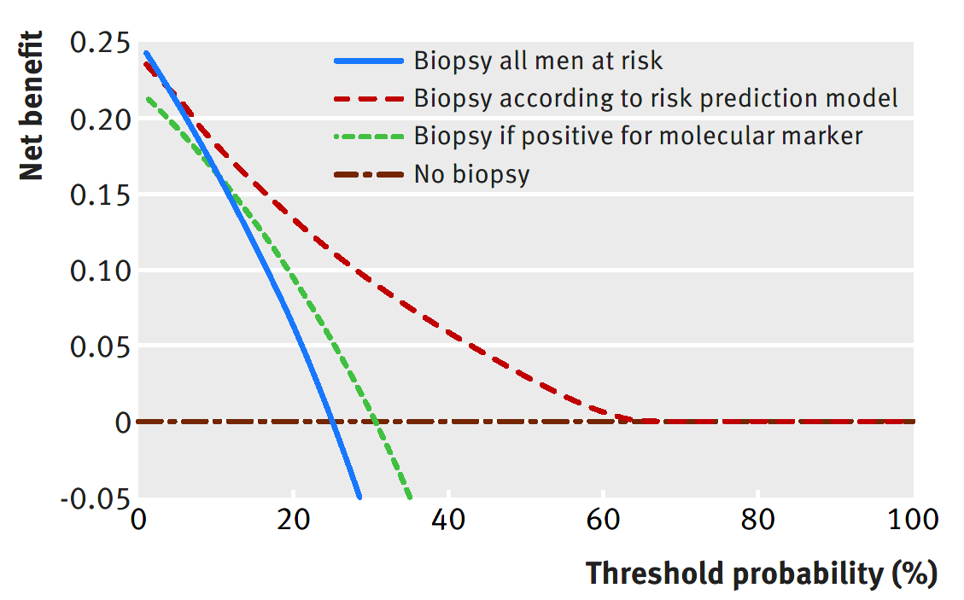
Decision curve
Net benefit vs. a range of threshold probabilities

Slide 10
Interpretation of decision curve
The approach with the highest net benefit at a desired threshold has highest clinical value.

Slide 11
Misconception
Net benefit should NOT be used to determine the threshold
Given an optimal threshold, it tells us the relative benefit of each approach

Slide 12
Summary
Trade-off of benefits and harms
Exchange rate to bring both on the same scale
Key parameter: threshold probability (p_{t})
Net benefit:
Decision curve: net benefit over a range of threshold probabilities
Exchange rate

Slide 13
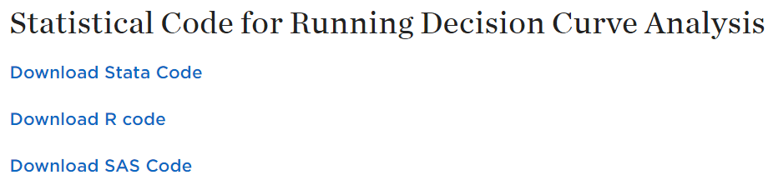
Software
Sample codes available for R, SAS and STATA
https://www.mskcc.org/departments/epidemiology-biostatistics/biostatistics/decision-curve-analysis
R package: ‘rmda’
https://mdbrown.github.io/rmda/

